Slide 1

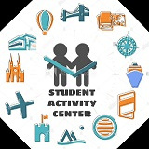


Madanapalle Institute of Technology and Science
(UGC-AUTONOMOUS INSTITUTION)
Affliated to JNTUA, Ananthapuramu & Approved by AICTE, New Delhi
NAAC Accredited with A+ Grade, NIRF India Rankings 2021-Band:201-250 (Engg.)
NBA Accredited - B.Tech (CIVIL, CSE, ECE, EEE, MECH), MBA & MCA
SKILL BEE
NURTURING SKILLS, BUILDING SUCCESS.
ABOUT CLUB
In Skill bee club, students will be functioning as mentors for other students, which means that if one student is knowledgeable about a particular skill or certain talent, He or she will be sharing that skill with other students

Slide 2


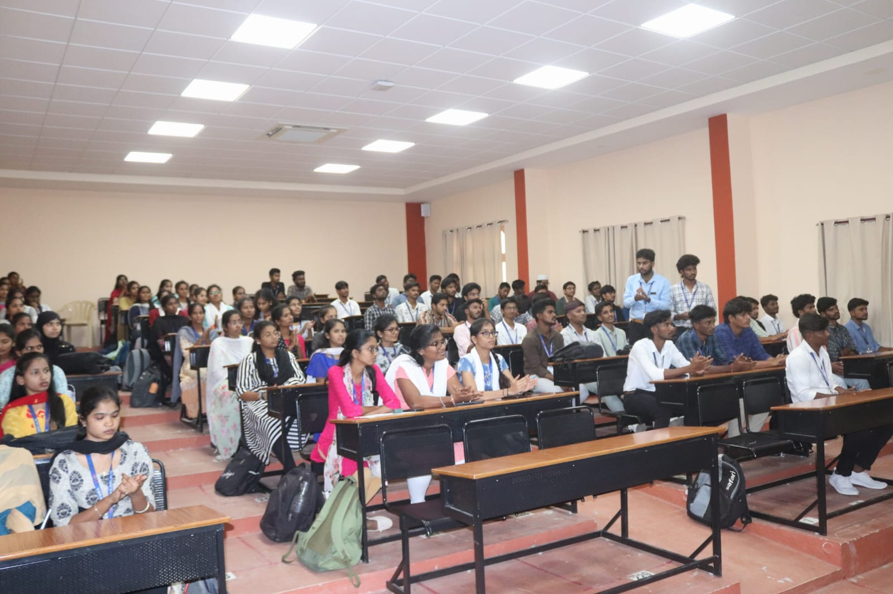
VISION
We want to see at least one skill in every student's resume which they learnt through our Skill Bee club.

Slide 3

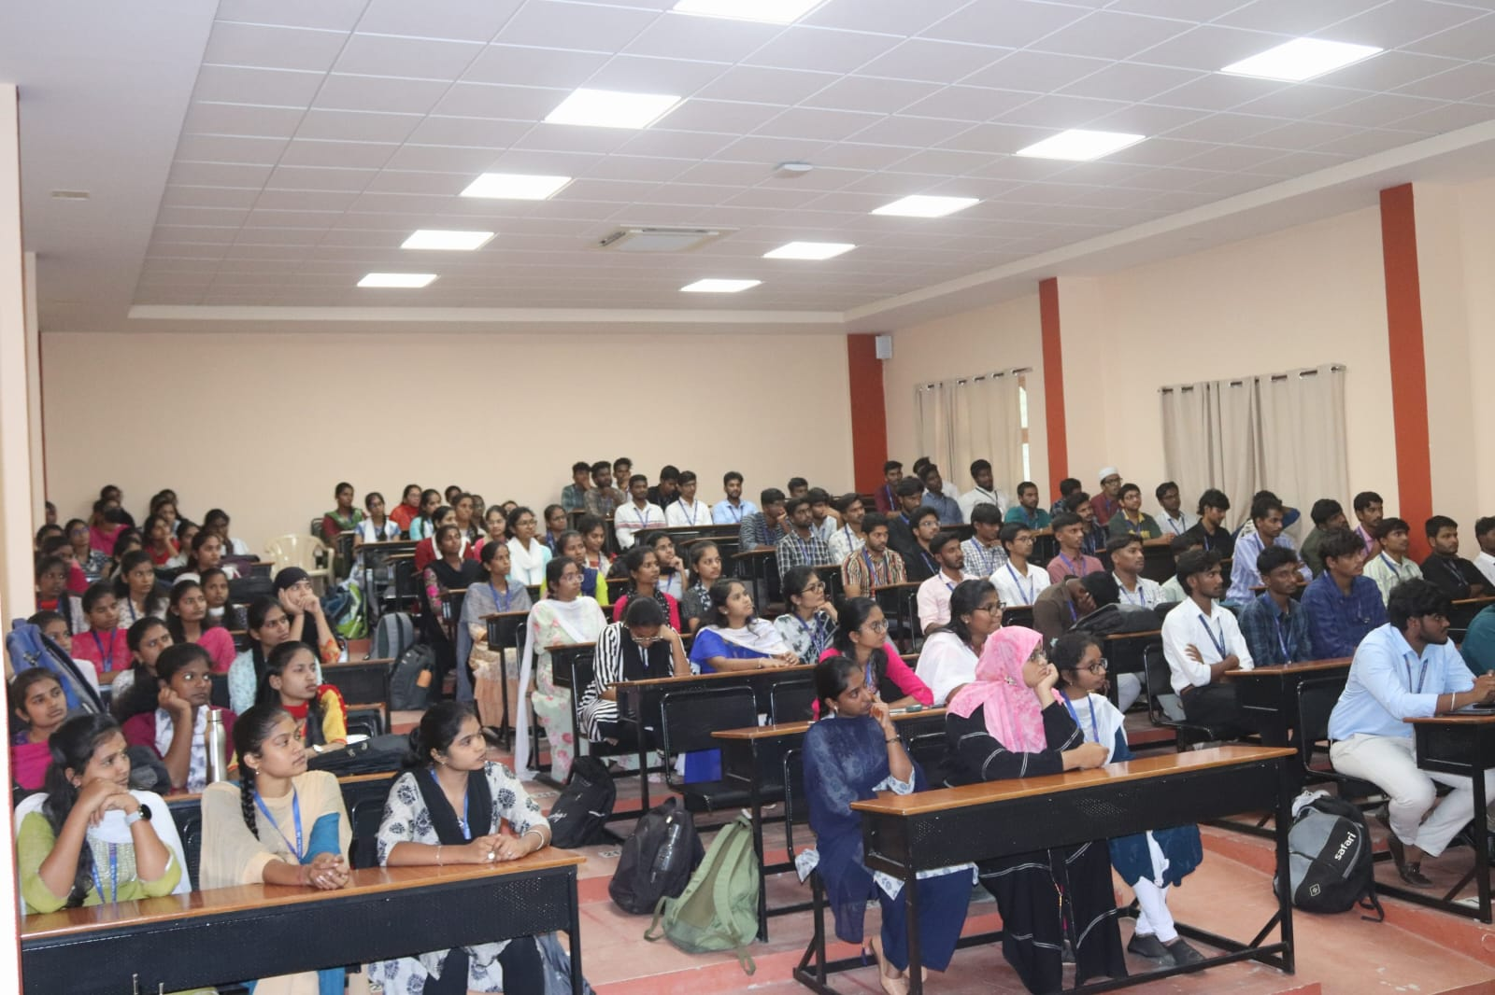
MISSION
To ensure the improvement of the capability of students in learning, understanding, teaching and also expressing their skills confidently.

Slide 4


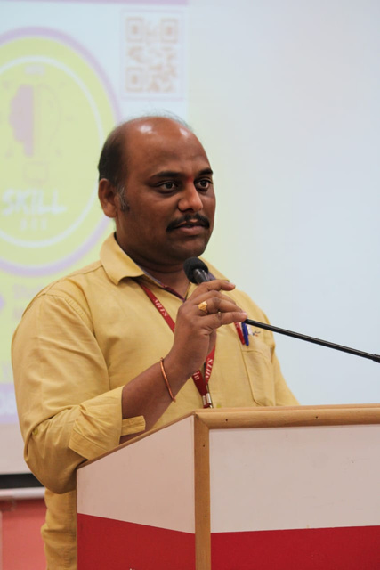
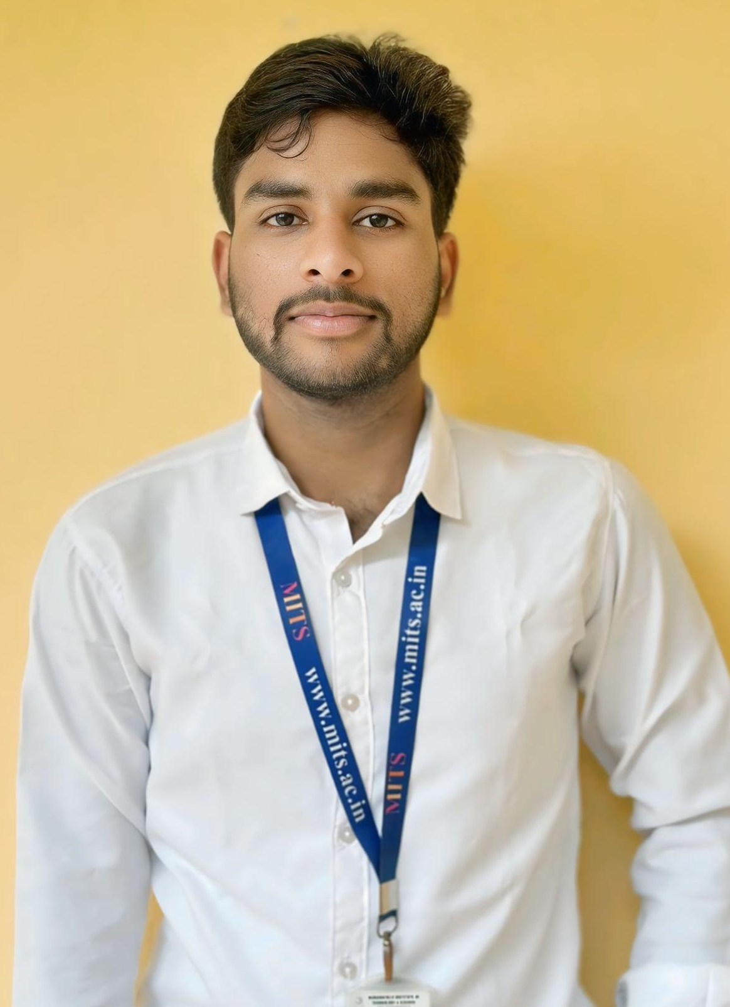
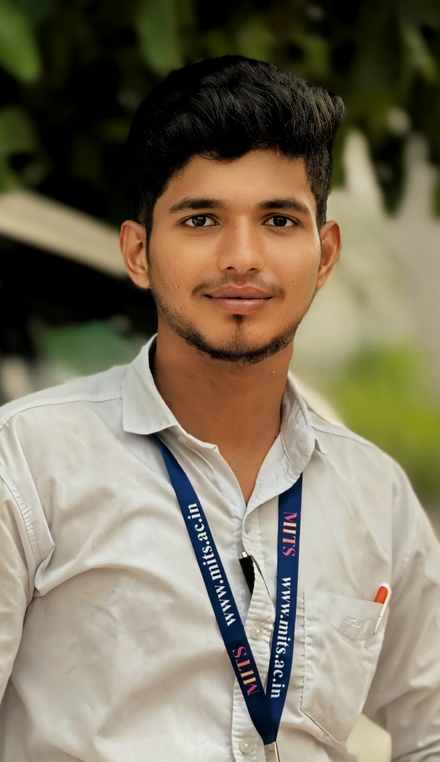
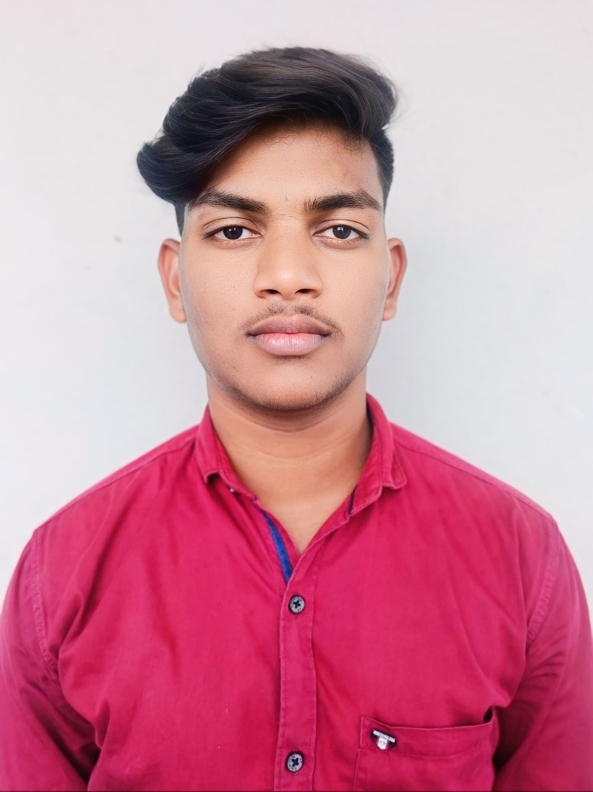
OUR TEAM
MR K. DURGA CHARAN
Mr. M.GNANA SRIKAR YADAV
STUDENT COORDINATOR
FACULTY COORDINATOR
  Mr. K Durga Charan, Assistant Professor at the Department of Data Science, serves as the Faculty Coordinator for the club.
  Mr. M Gnana Srikar Yadav, a second-year student specializing in Data Science, has taken on the role of Student Coordinator.
  Mr. M Abdul Kalam holds the position of Secretary for the club.
  Mr. R Balu holds the position of Treasurer for the club.
Mr. M. ABDUL KALAM
SECRETARY
Mr. R.BALU TREASURER

Slide 5
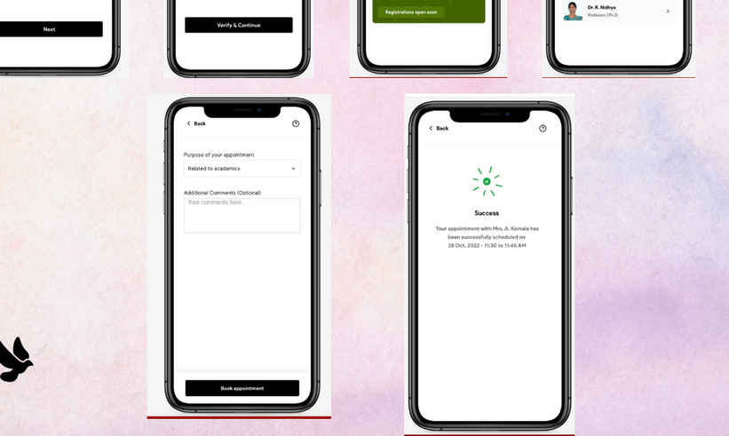
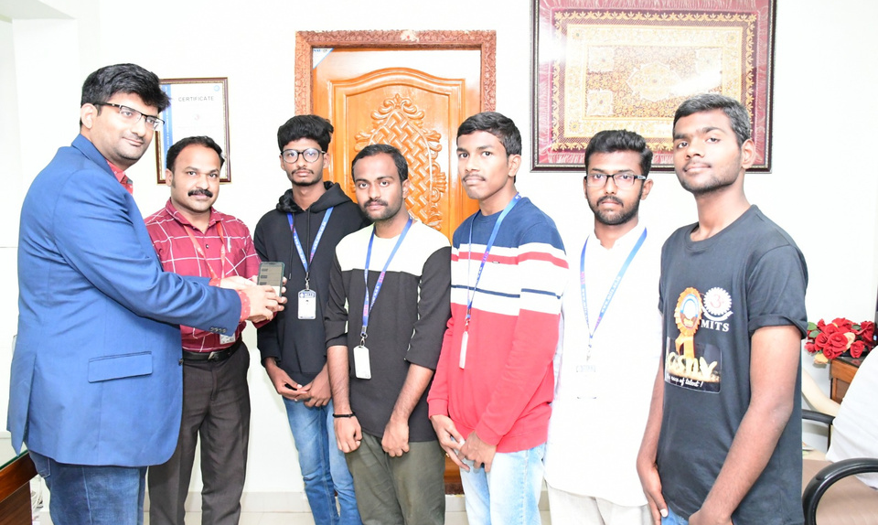
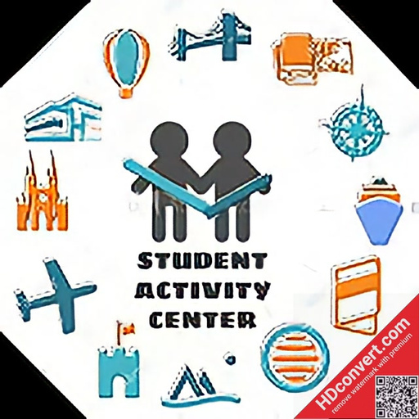
OUR MAJOR EVENTS
BUILD YOUR FIRST MOBILE APP
The main objective of this event is inaugurating of our Skill bee club and to motivate students about how easy it is to develop an android application, PayScale’s of android app development, Freelancing opportunities and to teach about different concepts related to android app development

Slide 6
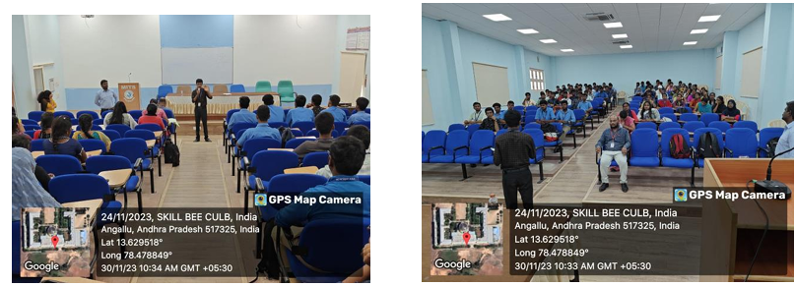
OPEN MIC MASTERING
The main objective of this event was to introduce public speaking as a learnable skill, help students overcome stage fear, and highlight its importance in personal and professional growth. It aimed to break common myths, boost confidence, and encourage students to express themselves through engaging sessions, expert talks, and active participation.

Slide 7
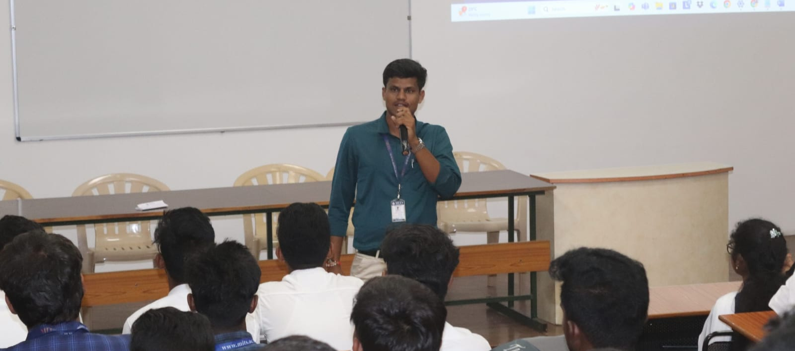
EMPOWER YOUR VOICE
The main objective of this event is
to motivate students to overcome stage fear, improve their communication skills, and build self-confidence. The event also aimed to highlight the importance of public speaking, leadership, and self-expression in both personal and professional life. Through expert-led sessions, students were introduced to key concepts like stage presence, body language, storytelling, and the significance of leadership and clear communication

Slide 8
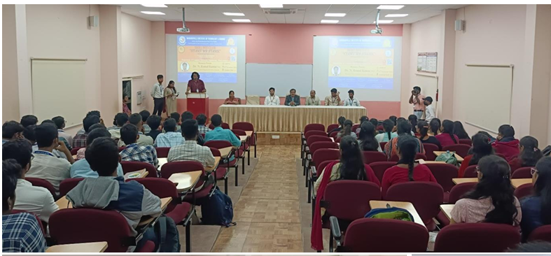
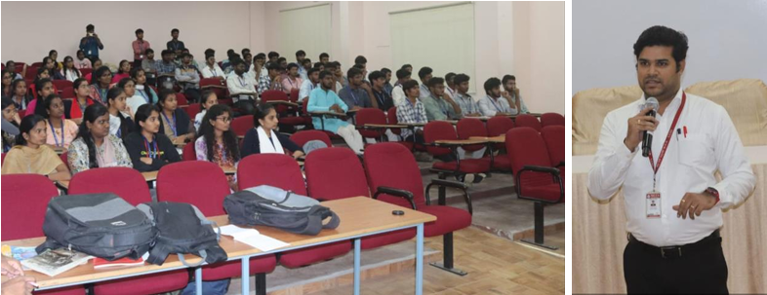
START UP STARK
The main objective of this event is
to motivate students to explore the world of entrepreneurship and startups. It aimed to educate them on how startup ideas can be transformed into successful ventures, the differences between startups and traditional businesses, and the role of innovation in solving real-world problems. The event also highlighted funding opportunities, market trends, and the importance of networking, while inspiring students to develop confidence, communication, and leadership skills essential for entrepreneurial success.

Slide 9
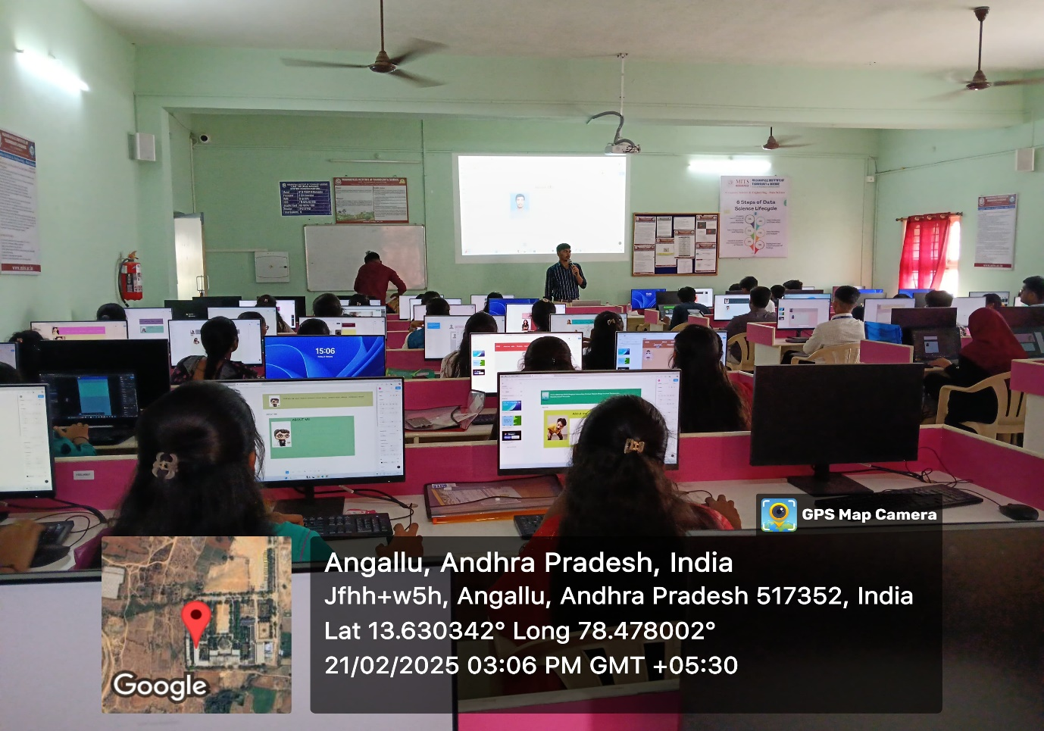
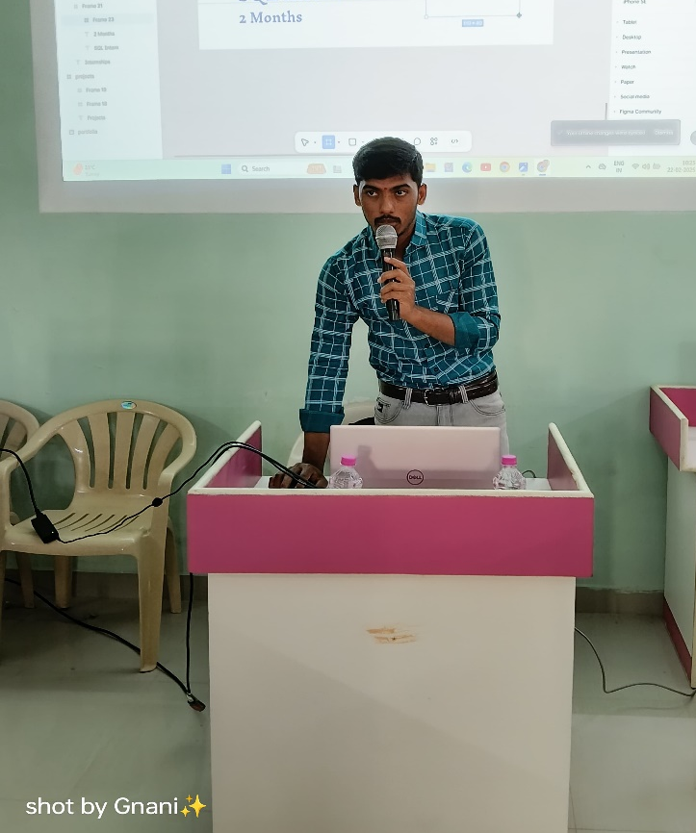
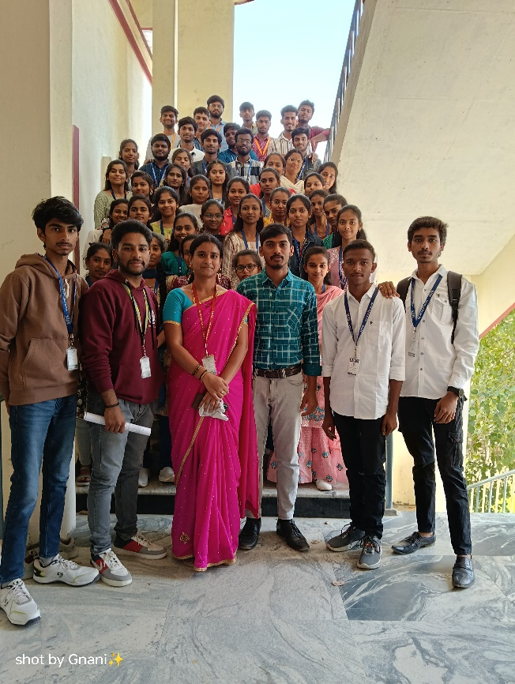
UI/UX DESIGN PROTOTYPING
WORKSHOP
The main objective of this event is
to motivate students by showing how simple and impactful UI/UX design can be. It aimed to introduce the fundamentals of user interface and user experience design, the tools used in the industry, and the growing demand for skilled designers. The event also highlighted freelancing opportunities, the potential pay scale in UI/UX roles, and provided hands-on training in designing responsive and user-friendly web pages, preparing students for real-world design and development careers.

Slide 10


In-Person Workshop
THE PROCESS
  In the first step, we will conduct an engaging and interactive in-person workshop held in a suitable hall.
  During this workshop, participants will receive hands-on instruction and guidance, where we will cover the basics of the topic.
  The workshop will span 2-3 hours, ensuring that participants gain a strong foundation in the subject matter.
This two-step approach combines the benefits of hands-on, in-person instruction with the flexibility and accessibility of online resources, ensuring that participants receive a comprehensive and valuable learning experience.
Online Learning
  Following the initial workshop, we are committed to facilitating ongoing learning and skill development.
  To achieve this, we will maintain an active YouTube channel where participants can access a wealth of educational resources.
  We will sharing informative videos, tutorials, and supplementary materials to support continuous learning and skill enhancement.

Slide 11
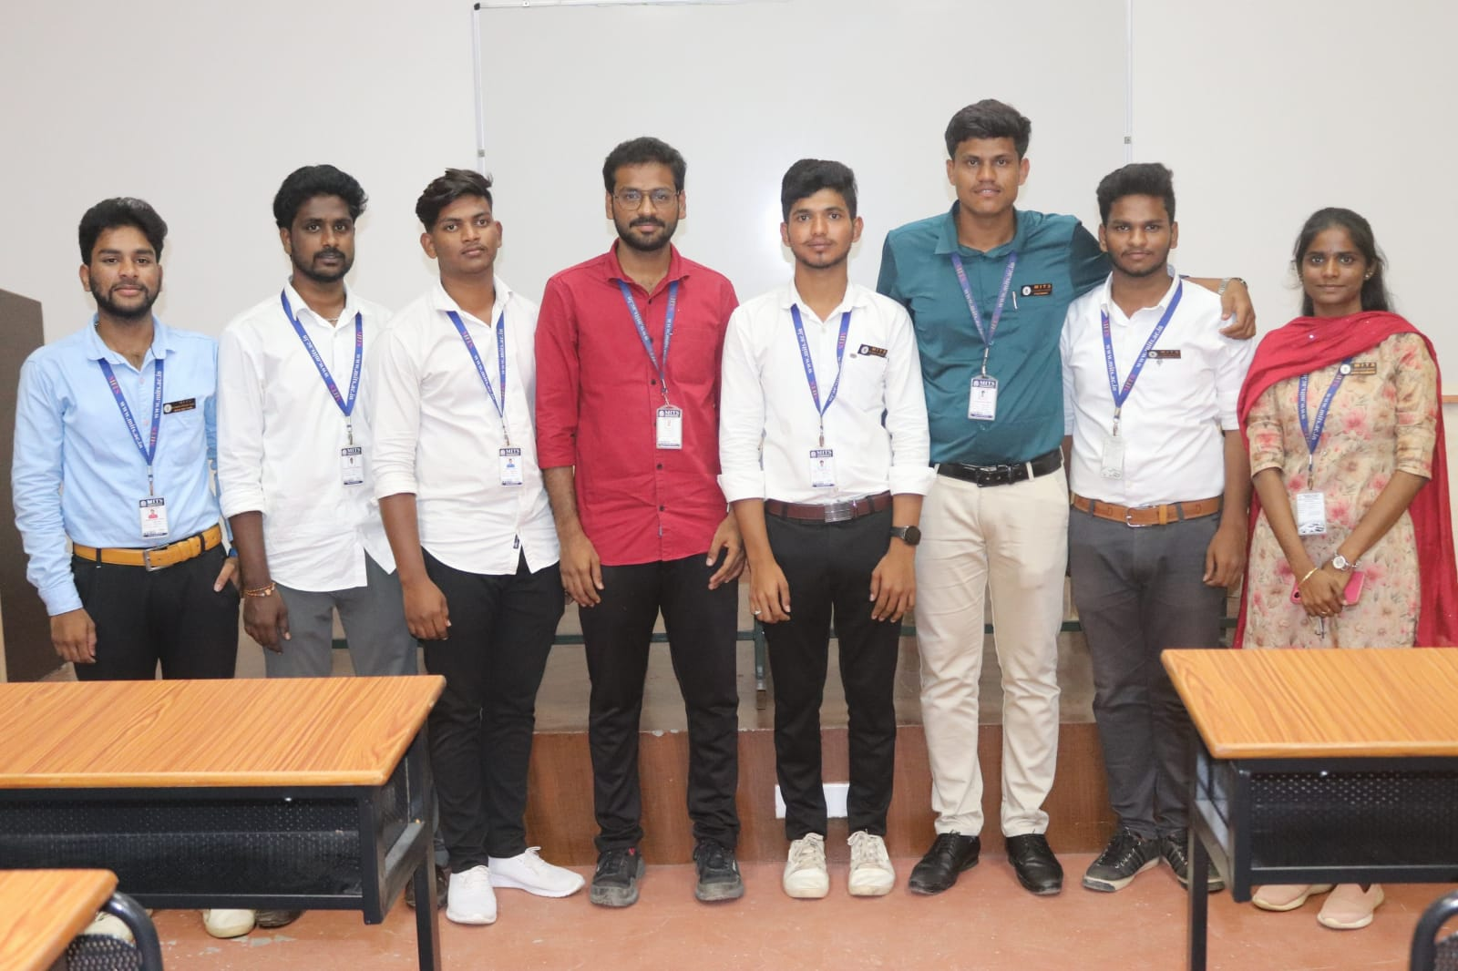
STAY INSPIRED. NEVER STOP LEARNING.

Slide 12
THANK YOU

